Slide 1
<CSE 4126> <Distributed Database Systems Lab>
G. M. Shahariar
<Department of Computer Science & engineering>
<Ahsanullah University of Science & Technology>

Slide 2
Today’s Objectives
Software Installation
Execute SQL commands via scripts
Work on SQL*PLUS
Work with basic SQL commands

Slide 3
Software Installation
Software – Oracle 10g, SQL*PLUS
Software Installation – Follow “Installation Procedure.pdf”

Slide 4
Getting Started
C:\oraclexe\app\oracle\product\10.2.0\server\BIN Find – “sqlplus.exe” Run it.

Slide 5
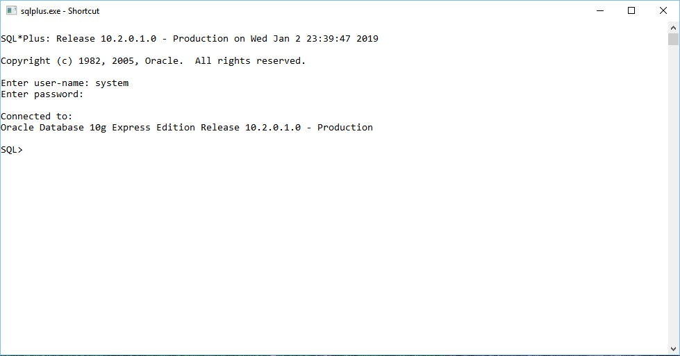

Slide 6
Type:
select * from dual;
Just to be sure everything okay

Slide 7
Revising Basic SQL Commands
DDL (Data Definition Language) :
CREATE
DROP
ALTER
TRUNCATE
COMMENT
RENAME
DML (Data Manipulation Language) :
SELECT
INSERT
UPDATE
DELETE

Slide 8
Your Task -
Drop if there is a table named “money”
Create a table named “money” which has attributes/columns (id, name, taka)
Insert some rows into “money” table.

Slide 9
SQL Commands via Script
Open Notepad++
Create a new file and save it as “myquery.sql”
clear screen;
drop table money;
create table money(id number, name varchar2(20), taka number);
insert into money values(1,'A',100);
insert into money values(2,'B',110);
insert into money values(3,'C',120);

Slide 10
Executing SQL Commands via Script
Go to SQLPLUS command prompt
Type according to the following rule –
@Drivename:/Foldername/Foldername/…../myquery.sql;

Slide 11
Understanding Commit
Changes made to the database by INSERT, UPDATE and DELETE commands are temporary until explicitly committed. This is performed by the command.
commit;

Slide 12
clear screen;
drop table money;
create table money(id number, name varchar2(20), taka number);
insert into money values(1,'A',100);
insert into money values(2,'B',110);
insert into money values(3,'C',120);
commit;

Slide 13
Comments:
/* for multiple lines */
-- for single line

Slide 14
Join:
@..../……/join.sql;
Sub-query:
@..../……/subquery.sql;
Set:
@..../……/set.sql;

Slide 15
View
In SQL, a view is a virtual table based on the result-set of an SQL statement. A view contains rows and columns, just like a real table. The fields in a view are fields from one or more real tables in the database. You can add SQL functions, WHERE, and JOIN statements to a view and present the data as if the data were coming from one single table.
@..../……/view.sql;
@..../……/view2.sql;

Slide 16
You definitely should revise other SQL commands, such as – 1. alter 2. aggregate functions, scalar functions 3. having 4. group by 5. like 6. exists, not exists 7. check
Some other topics must be revised, such as – different data types, alias etc. A very good reference to brush up your SQL skill is https://www.w3schools.com/sql/sql_intro.asp

Slide 17
OFFLINE 01

